Slide 1
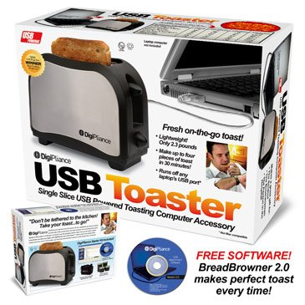
Risk Benefit Analysis for Toast-USB Launch
Nijia Ke, Nicholas Mobley, Allison McCarty
04/01/2021

Slide 2
Outline
Introduction
Data processing
Comparisons of the two samples
Exploratory data analysis
Data Modeling
Application of model to determine a Manufacturer suggested Retail Price (MSRP)
Conclusions and discussions

Slide 3
Introduction: Data
5 major metropolitan areas
Sample 1: 421 observations of 8 variables; 50.36% in favor
Sample 2: 45,211 observations of 17 variables; response rate?
Break-even response rate: 24.13%

Slide 4
Introduction: Specific Aims
Specific Aim 1: To compare the demographic features of the two samples qualitatively and quantitatively.
Specific Aim 2: To recommend on whether the client should move forward with the campaign and provide suggestions on campaign strategies.
Specific Aims 3: To determine a Manufacturer Suggested Retail Price (MSRP) which optimizes revenue.

Slide 5
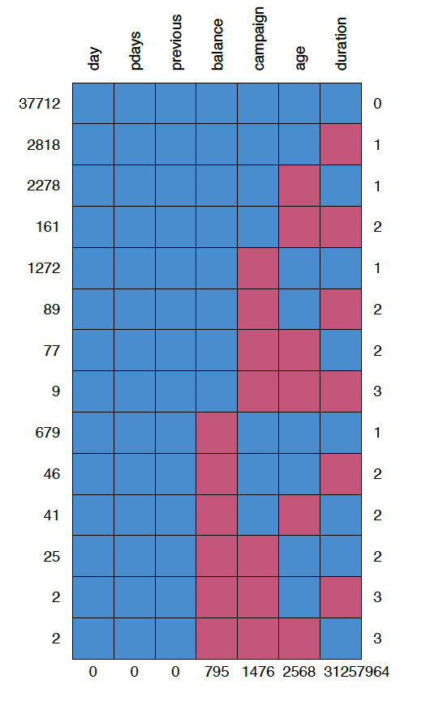
Data Processing
17,216 (38.10%) ≥1 missing values
Categorical variables (“Unknown”)
Numeric variables
439 (0.97%) ≥2 missing num. variables
Missing at random
Replace missing values with the medians

Slide 6
Comparisons of the Two Samples
Age
Balance
Job
Education
Marital status Mortgage Primary phone
Variables common in both samples:
2 numeric variables
5 categorical variables
Credit in default
Personal
loan
Delinquency
Gender
Race

Slide 7
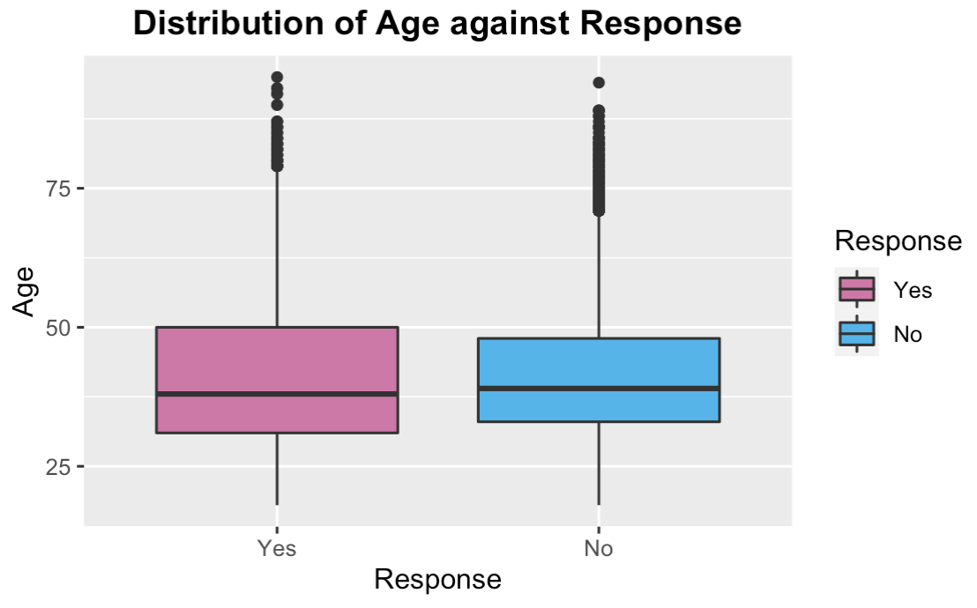
Age vs. Response
95% Confidence
Interval (sample 2)
Yes: 23 to 74
No: 25 to 60
Means (sample 1)
Yes: 25.5
No: 37.5

Slide 8
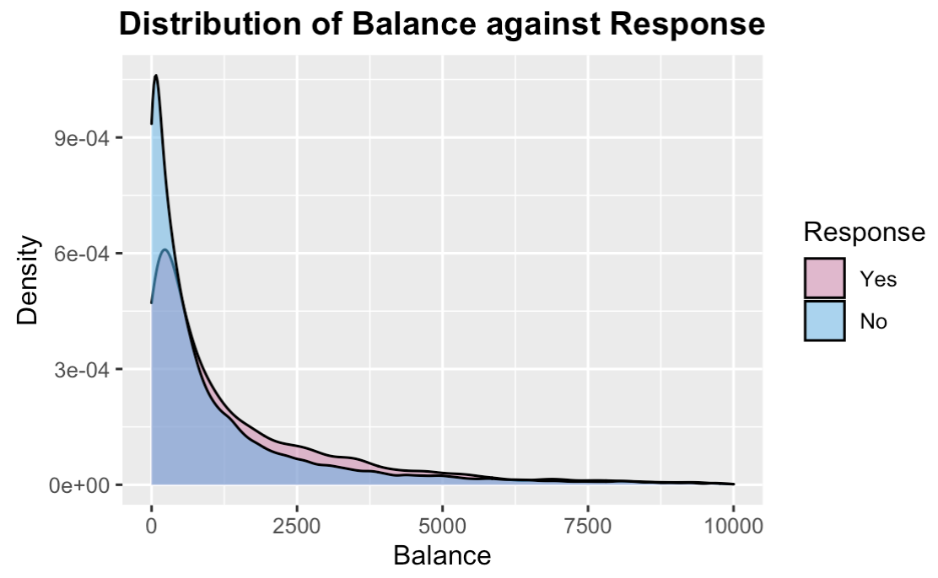
Non-mortgage Loan Balance vs. Response
95% Confidence
Interval (sample 2)
Yes: -$157.45 to $10,185
No: -$393 to $8,266
Means (sample 1)
Yes: $1,250
No: $23,879

Slide 9
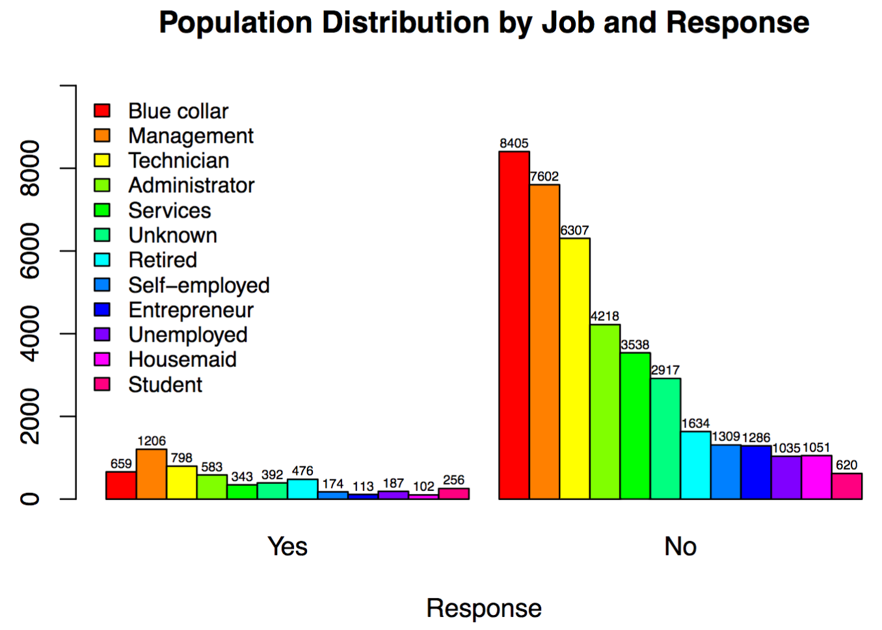
Job vs. Response
Most responds no
Common: Blue collar, Management, Technician
Uncommon: Housemaid and Student

Slide 10
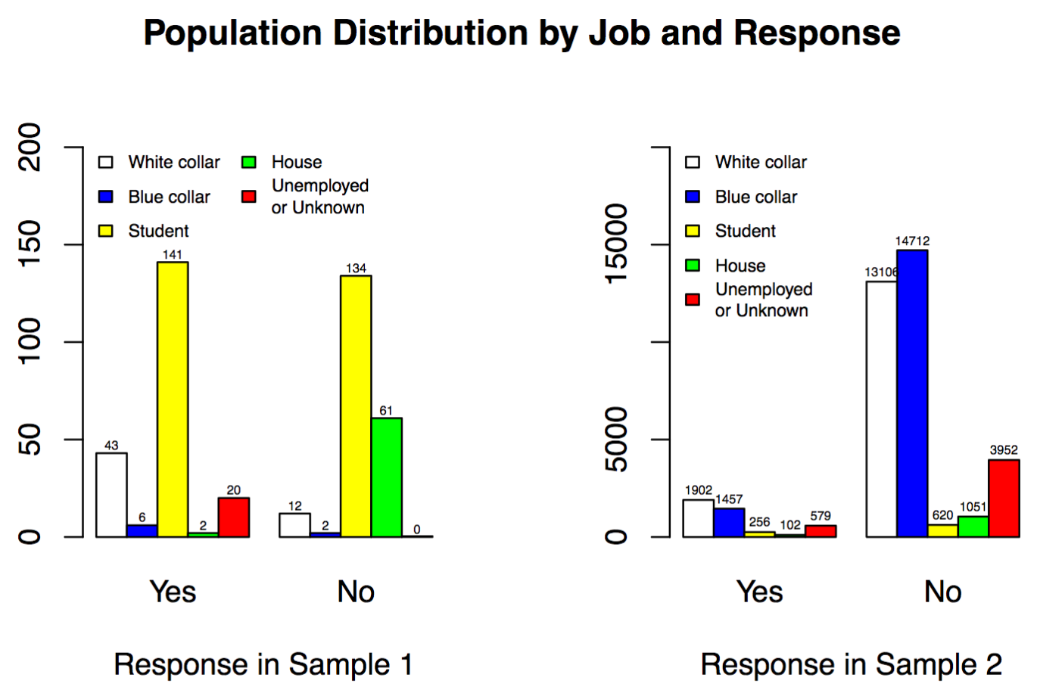
Job vs. Response in Two Samples
Sample 1: most are students, hardly any blue collars
Only housemaids behave similarly in
both samples

Slide 11
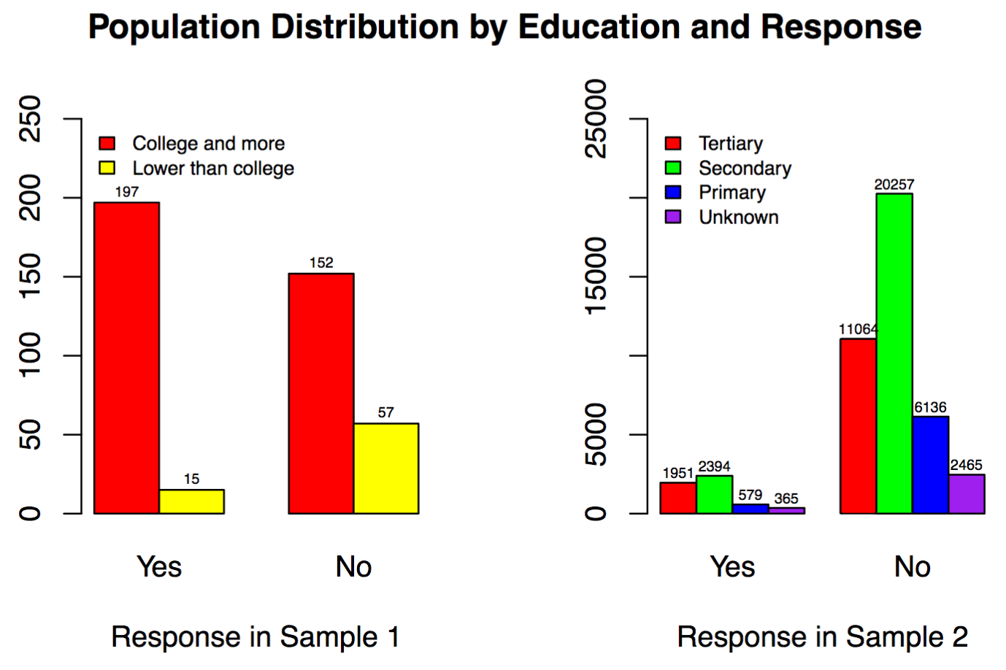
Education vs. Response in Two Samples
College and more = Tertiary
Lower than college = Secondary + Primary
Sample 1: College and more has more response in favor

Slide 12
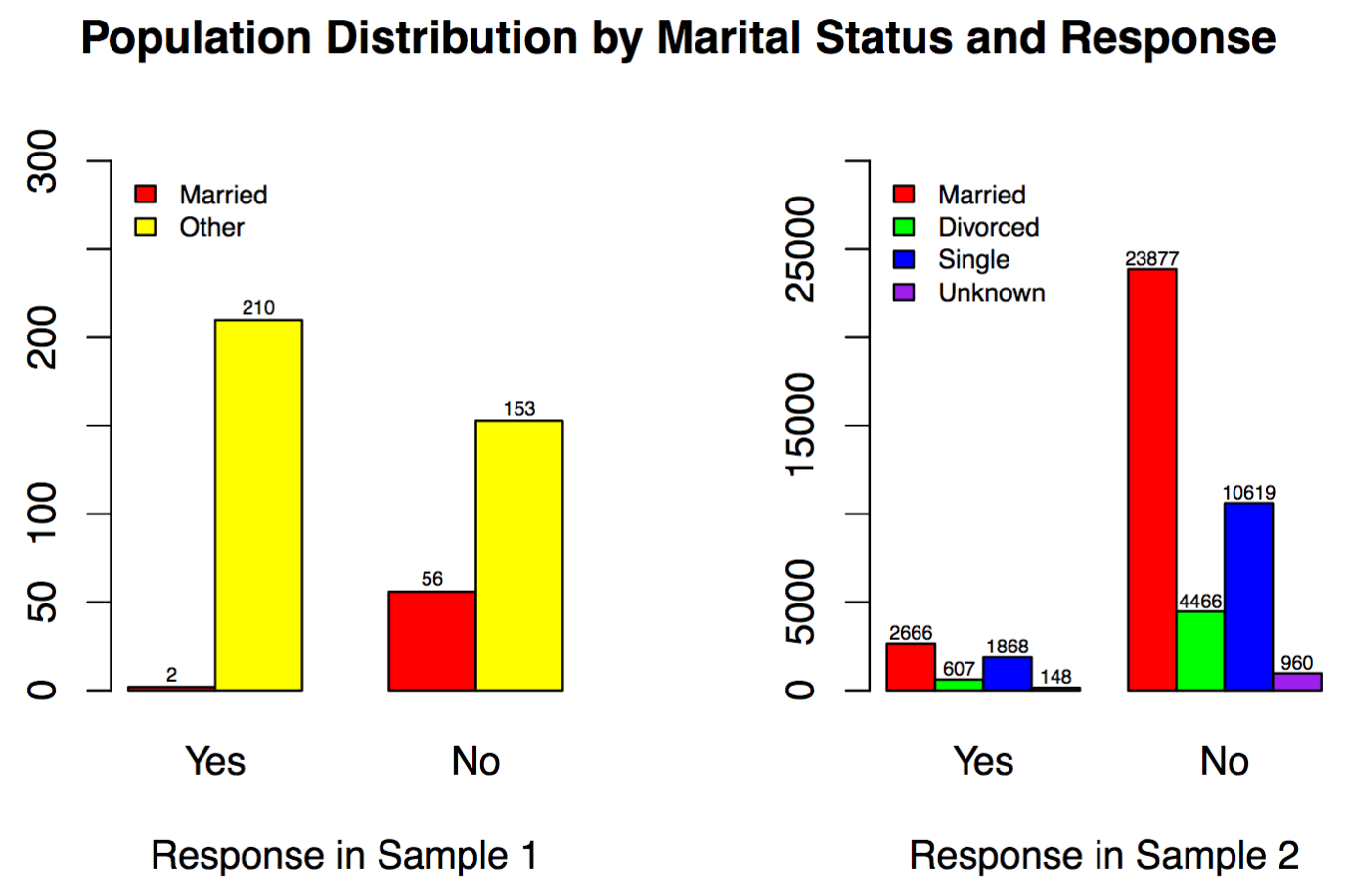
Marital Status vs. Response in Two Samples
Other = Divorced
+ Single + Unknown
Sample 1: married are limited
Married respondents not willing to buy

Slide 13
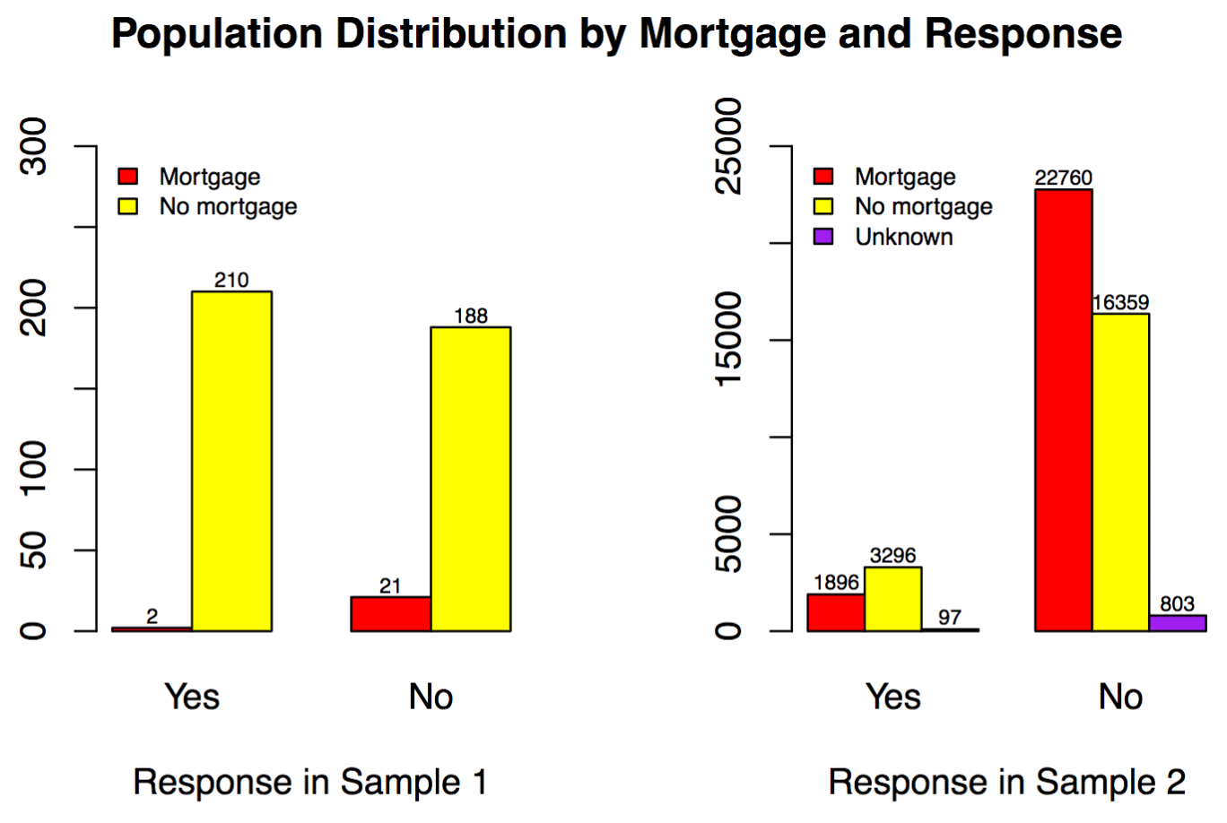
Mortgage vs. Response in Two Samples
Sample 1: fewer respondents with mortgage
Mortgage: Less likely to buy
No mortgage: respond in conflicting trends

Slide 14
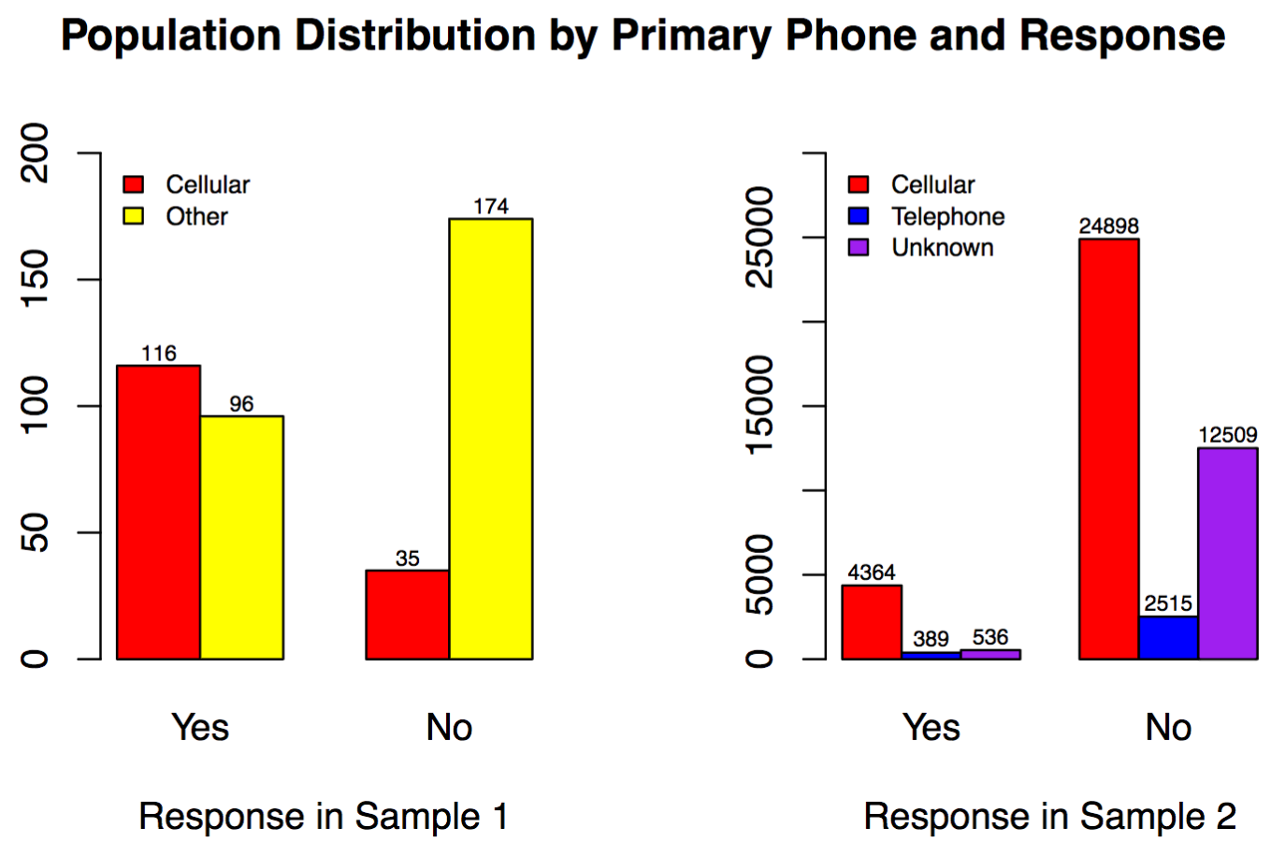
Primary phone vs. Response in Two Samples
Other = Telephone
+ Unknown
Cellular
Sample 1: ≤ 1/2
Sample 2: ≥ 1/2
Respond in opposite tendencies

Slide 15
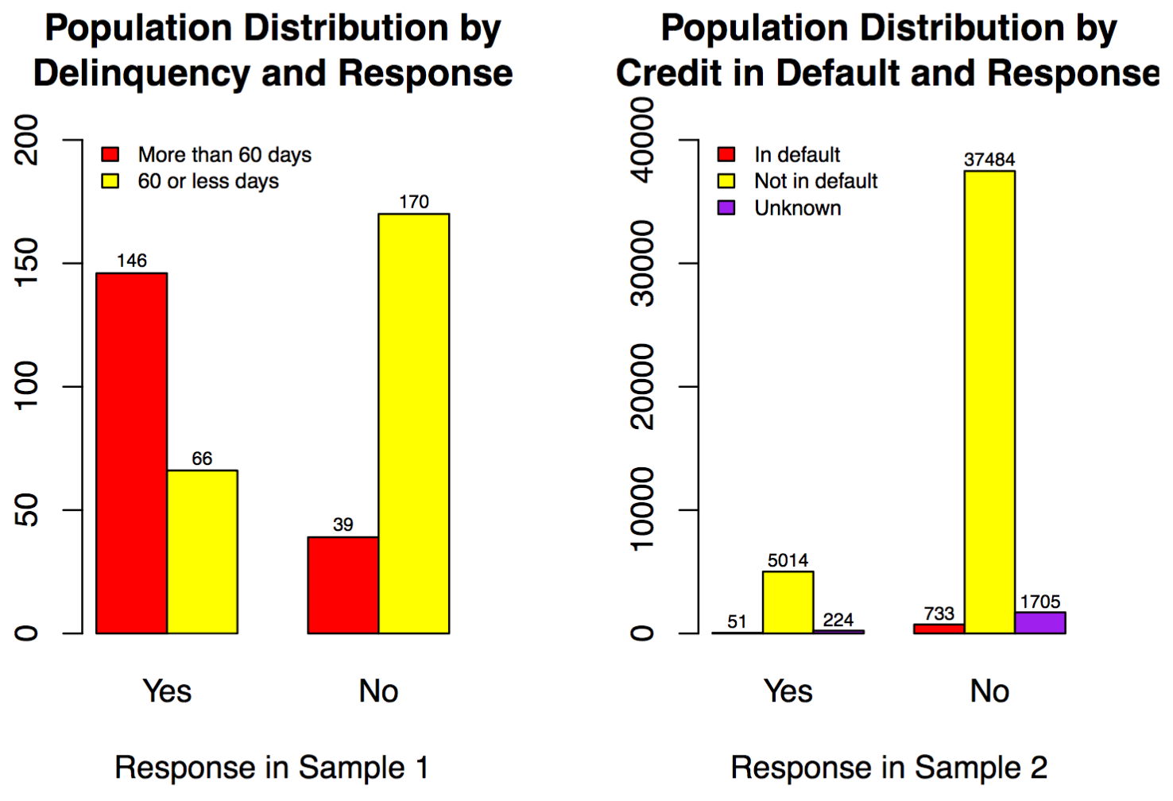
Delinquency vs. Credit in Default
Delinquency ≈ Credit in Default
Sample 2: the majority are not in default
Similar response trend

Slide 16
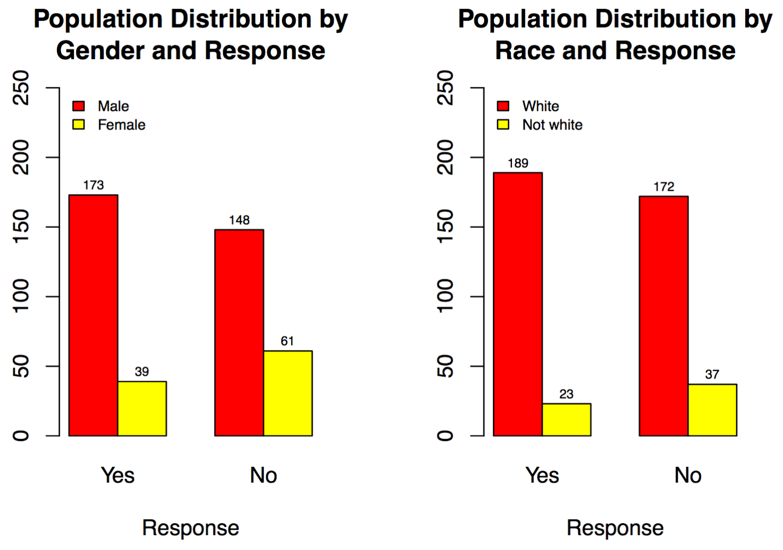
Gender vs. Race in Sample 1
Male and White are overrepresented
Similar patterns of response for both Gender and Race

Slide 17
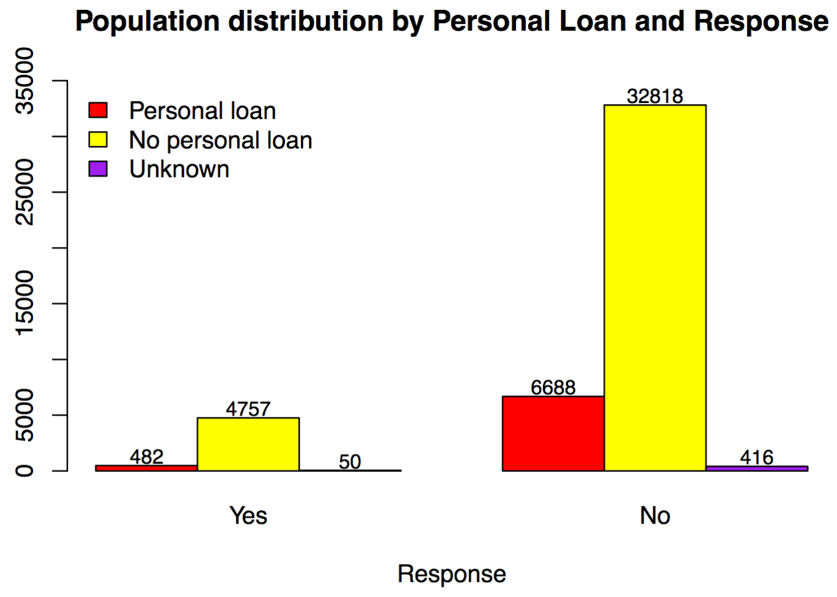
Personal Loan vs. Response in Sample 2
Regardless of having personal loan or not, respondents both tend to not buy the product

Slide 18
Summary: Comparisons of the Two Samples
Variables | Overrepresented | underrepresented
Job | Student | Blue collar
Education | College and more
Marital status |  | Married
Mortgage |  | With mortgage
Primary phone |  | Cellular
Second sample: more respondents who are not willing to purchase the product than those who are.

Slide 19
Results of Likelihood Ratio Tests
Sample 1: Response is significantly associated with Job, Education, Marital status, Mortgage, Primary phone, Delinquency, Gender and Race
Sample 2: Response is significantly associated with Job, Education, Marital status, Mortgage, Primary phone, Credit in default and Personal loan
Sample 1 and Sample 2 (5 variables in common): not from the same population

Slide 20
Exploratory Data Analysis
Goal: To find variables such that they will create a linear boundary between the two classes, “willing to purchase” and “not willing to purchase”

Slide 21
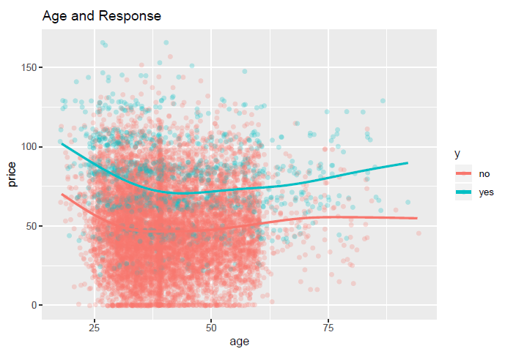
Age and Price
Respondents with higher price value or more willing to purchase
Older age demographic more willing to purchase.

Slide 22
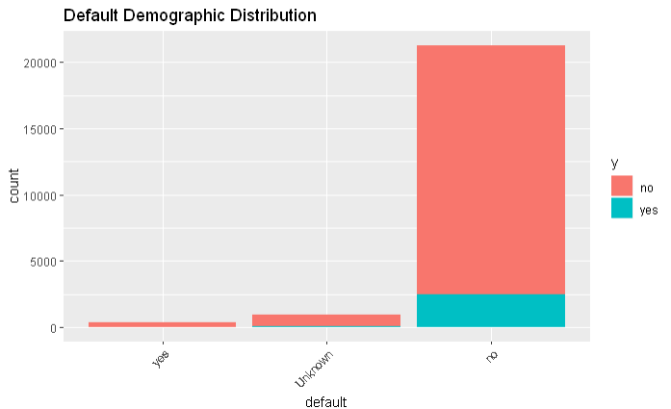
Default on Credit
Not defaulting on credit, improves likelihood of purchase

Slide 23
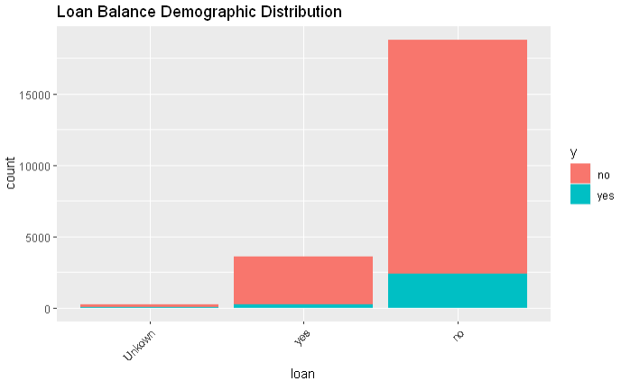
Non-mortgage Loan Status
People without loans more willing to purchase
Financial freedom improves likelihood

Slide 24
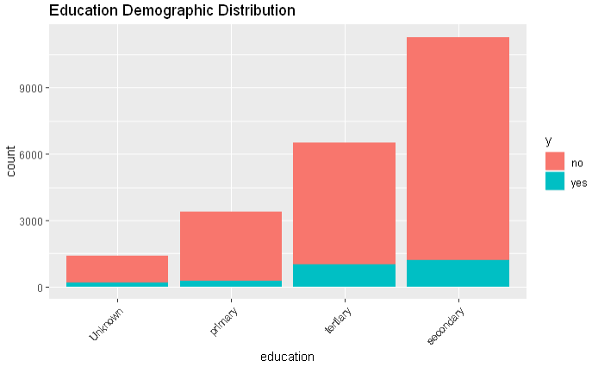
Level of Education
Individuals with tertiary and secondary education are more likely to purchase.

Slide 25
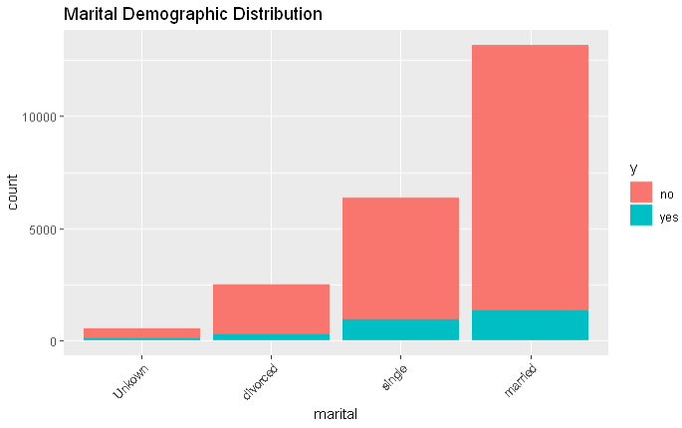
Non-informative Variables
Marital Status shows little to no difference in difference in proportions.

Slide 26
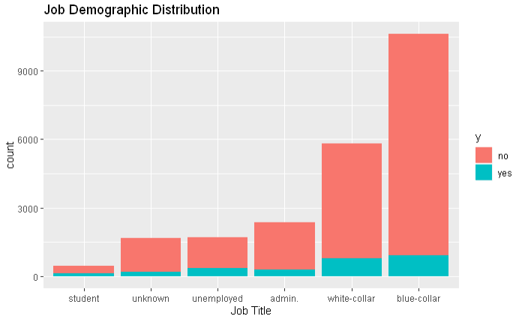
Job

Slide 27
Modeling Process
Selected variables Age, default, loan status, and education.
Only 15 possible models when considering to include variable or not.
We tried every model picking the best one, using cross-validation to ensure we did not overfit.

Slide 28
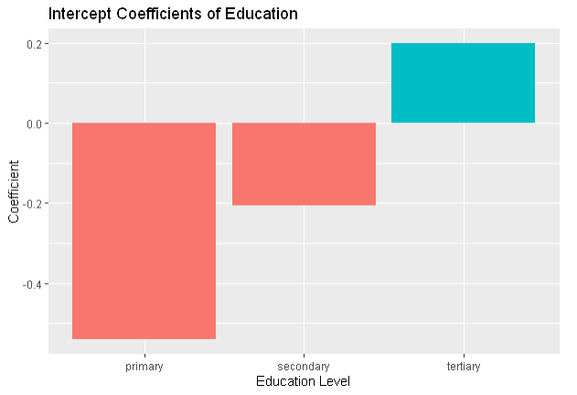
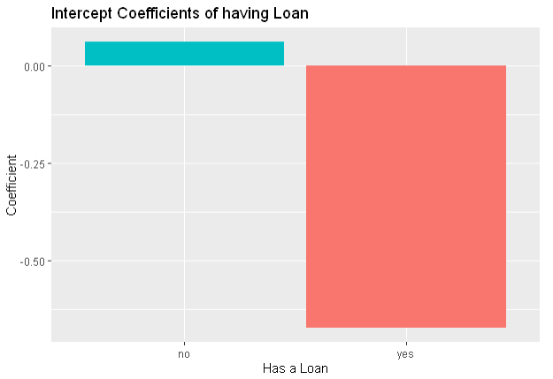
Model Results
Tertiary educated individuals without a loan will be the most likely group to advertise to.

Slide 29
The estimated Response Rate
We withheld 50% of our data to test our model against.
For every observation, the model gave a predicted probability of a purchase.
From these probabilities we have an estimated favorable response rate of 12.14%

Slide 30
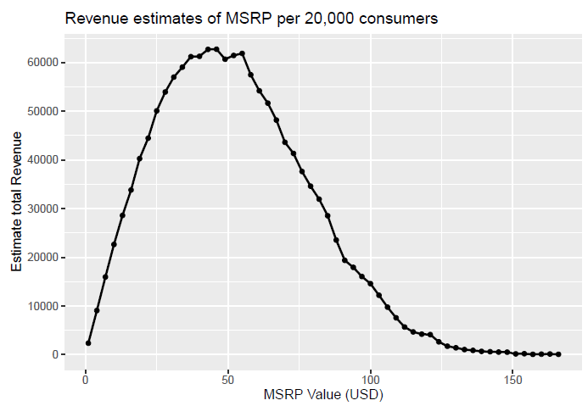
Suggested MSRP
Simulation on test set using probabilities of purchase and price willing to pay to estimate revenue.

Slide 31
Conclusion & Further Discussion
Results of our likelihood test suggest that initial survey was not representative of greater population
Results of logistic regression modeling suggest a 12.14% favorable response rate.
However, the marketing could be more tailer to older highly more highly educated individuals, who have a higher favorable response
If launch of product does occur, our suggested MSRP is roughly $49.99.

